Slide 1


Occupational Health and Safety (OHS) Program
Union of Taxation Employees Health and Safety Conference
November 1, 2024

Slide 2

Agenda
Introduction to OHS at the Canada Revenue Agency
Overview of the program
Psychological Health and Safety
Incident Reporting and Disability Management System (IRDMS)
OHS Reports Portal
Ergonomics – Injury Prevention Program
Workplace Harassment and Violence Prevention

Slide 3

At the Canada Revenue Agency (CRA), we are dedicated to providing a healthy and safe work environment for all employees by fostering an organizational culture where health and safety is fundamental in every aspect of the CRA's business.

Slide 4
Occupational Health and Safety Management System
Do
Check
Act
Plan

Slide 5
OHS Program Structure
Occupational Health and Safety Program
Hazard Prevention Program
Training and Awareness
Legislation and Policies
NHSPC / HSC
Reporting & Monitoring
Continuous Improvement
Change Management

Slide 6
Hazard Prevention Program (HPP)
The HPP is a tool that encompasses all the efforts undertaken in occupational health and safety in the workplace, and
identifies how hazards and risks would be mitigated
The purpose of the HPP is to prevent accidents and injuries from occurring in the course of employment in the CRA.

Slide 7
Details of OHS Program
OHS Training Products
Consultation Groups
Technological Systems
Policy Instruments
Volunteer Activities
Contracts

Slide 8

OHS Network Within the CRA
National OHS Section
National Health and Safety Policy Committee
Policy development
National monitoring and reporting
Manage NHSPC
Consultation forum for employer and employee representatives to meet, exchange information, discuss and consider national OHS issues within the CRA
Occupational Health and Safety Officers
Regional monitoring and reporting of OHS policies and prevention initiatives
Support HSCs and HSRs
Health and Safety Committees
Consultation forum for employer and employee representatives to meet, exchange information, discuss, consider and make recommendations on local OHS issues
Health and Safety representatives
Evaluate and consider local OHS issues, make recommendations to local management and to communicate OHS issues and concerns to employees
Regional OHS expertise

Slide 9

Roles and responsibilities
HSCs and HSRs are an important part of what is called the internal responsibility system.
This system, based on cooperation between employers and employees, improves the overall understanding of occupational health and safety issues in the workplace.

Slide 10

What role can the Health & Safety Committee and Representative play?
  Have proactive discussions on the control of hazards in the workplace
  Workplace inspections and participate in OHS investigations
  Provide employees with information on OHS topics (Safety and Health Week, etc.)
  Provide recommendations to management
  Discuss local employee health and safety concerns
  Participate in OHS Program monitoring & stay connected to other HSCs
  Link in with Ergonomic Coaches, First Aid/AED Coordinators/Responders and Building Emergency Organization

Slide 11

Workplace factors that affect well-being

Slide 12



CRA’s well-being approach
The CRA’s well-being approach identifies three priorities that will help the CRA foster a healthy workplace:
1. Support individual, team, and organizational well-being
2. Reinforce how we embed healthy workplace principles in everything we do
3. Actively manage the workplace factors that can affect well-being

Slide 13
Why does a healthy workplace matter?
“The health of an organization…is the single greatest factor for determining an organization's success. More than talent. More than knowledge. More than innovation.” ^{[1]}
Quote by Patrick Lencioni
A healthy workplace is mutually beneficial to individuals, teams, and the organization.
A psychologically healthy and safe workplace is one that:
prioritizes employees, which in turn fuels creativity, innovation, resilience, retention, performance, and excellence
actively works to prevent harm to employees due to negligent, reckless or intentional acts
manages the workplace factors that affect employee well-being and psychological health

Slide 14
Workplace factors
  The Federal Public Service ^{[2]} and Canadian private sector widely recognizes 13 workplace factors (also called psychosocial factors or psychosocial risk factors) that affect well-being.^{[3]}
  When these factors are adequately managed, they can support the conditions for workplace well-being and performance.
  When these factors are not adequately managed, they can become hazards and potentially erode workplace well-being and performance. ^{[4]}
  The CRA is focusing on these workplace factors with the intention of supporting well-being and preventing risks to the psychological health and safety of employees.

Slide 15
The 13 Workplace Factors
Psychological and social support
Organizational culture
Clear leadership and expectations
Civility and respect
Psychological demands
Growth and development
Recognition and reward
Involvement and influence
Workload management
Engagement
Balance
Psychological protection
Protection of physical safety

Slide 16

13 Workplace Factors- Information Cards
The following information cards are intended to give you insight on the 13 workplace factors that can affect well-being and psychological health and safety in the workplace.
Each card contains:
the Government of Canada definition of the workplace factor ^{[5]}
an explanation of what that factor looks like in the work environment when it is well managed (adapted from the CSA Standard) ^{[3]}

Slide 17
Organizational culture
Definition
What it looks like in practice
A work environment characterized by trust, honesty, and fairness.
All people in the workplace are held accountable for their actions.
People at work show sincere respect for others’ ideas, values, and beliefs.
Difficult situations at work are addressed effectively and as early as possible.
Employees feel that they are part of a community at work.
Employees and management trust one another.
Employees feel comfortable expressing themselves in the official language of their choice.

Slide 18
Clear leadership and expectations
Definition
What it looks like in practice
A work environment where there is effective leadership and support that helps employees know what they need to do, how their work contributes to the organization, and whether there are changes coming.
In their jobs, employees know what they are expected to do.
Leadership in the workplace is effective.
Employees are informed about important changes at work in a timely manner.
Supervisors provide helpful feedback to employees on their performance.
The employer provides clear and effective communication.

Slide 19
Psychological demands
Definition
What it looks like in practice
A work environment where employees’ interpersonal and emotional competencies fit with the requirements of their position.
The employer considers existing work systems and allows for work redesign.
The employer assesses employee demand and job control issues such as physical and psychological job demands.
The employer assesses the level of job control and autonomy afforded to its employees.
The employer values employee input particularly during periods of change and the execution of work.
The employer emphasizes recruitment, training, and promotion practices that aim for the highest level of interpersonal competencies at work.

Slide 20
Workload management
Definition
What it looks like in practice
A work environment where tasks and responsibilities can be accomplished successfully in the time available.
The amount of work employees are expected to do is reasonable for their positions.
Employees have the equipment and resources needed to do their jobs well.
Employees can talk to their supervisors about the amount of work they have to do.
Employees’ work is free from unnecessary interruptions and disruptions.
Employees have an appropriate level of control over prioritizing tasks and responsibilities when facing multiple demands.

Slide 21
Protection of physical safety
Definition
What it looks like in practice
A work environment where employees’ physical safety is ensured.
The employer cares about how the physical work environment impacts mental health.
Employees feel safe in their physical work environment.
The way work is scheduled allows for reasonable rest periods.
All health and safety concerns are taken seriously.
Employees asked to do work that they believe is unsafe, have no hesitation in refusing to do it.
Employees get sufficient training to perform their work safely.
The employer assesses the psychological demands of the jobs and the job environment to determine if it presents a hazard to employees’ health and safety.

Slide 22

Joint Participation
Psychological health and safety is increasingly being recognized as a major factor to overall well-being at work. As such, we may start to see an increase in psychological hazard and injury/illness reports for the HSC/HSR to jointly investigate with management.
Important: Investigators are required to maintain employee privacy in accordance with the Privacy Act and the CRA Privacy Policy when participating in these processes.

Slide 23
Recommendations
During investigations, the HSC/HSR investigator may recognize workplace factors which are creating or contributing to a hazard. It is important to remember that health and safety investigations are a fact-finding process and are not fault finding.
HSC/HSR recommendations should not be directed at an individual level, but rather at improving the health and safety of a task, process or team.
For example: “It is our recommendation that this team participate in team building activities to acknowledge each other's accomplishments and improve team culture.”

Slide 24




Who to call on for support
Workplace Health and Safety Operations
If the HSC/HSR has questions regarding their role and how they can improve psychological health and safety in their workplace, they can contact their OHS Officer by submitting an HR Service Centre ticket.
Informal Conflict Resolution (ICR) Program
ICR practitioners are available to support employees to build and maintain healthy (safe, respectful, and inclusive) workplace relationships. To learn more about the ICR program, contact the National ICR Program Office, or your regional ICR practitioner.
Employee Assistance Program
Short term counselling or assistance is available if employees are experiencing a personal, health, or work-related concern. EAP counselling services are also available to family members. Refer to Accessing EAP services.
National Well-being Office
For general questions related to the well-being approach, contact WELLBEING@cra-arc.gc.ca.

Slide 25

Resources
The CRA has a growing list of resources available for each of the 13 workplace factors on the Workplace factors that affect well-being (dce-eir.net) page on InfoZone.
Committees and representatives can reference resources from this list as part of their investigation recommendations to reduce the risk of psychological injury and illness in your workplace.

Slide 26

Incident Reporting and Disability Management System (IRDMS)

Slide 27
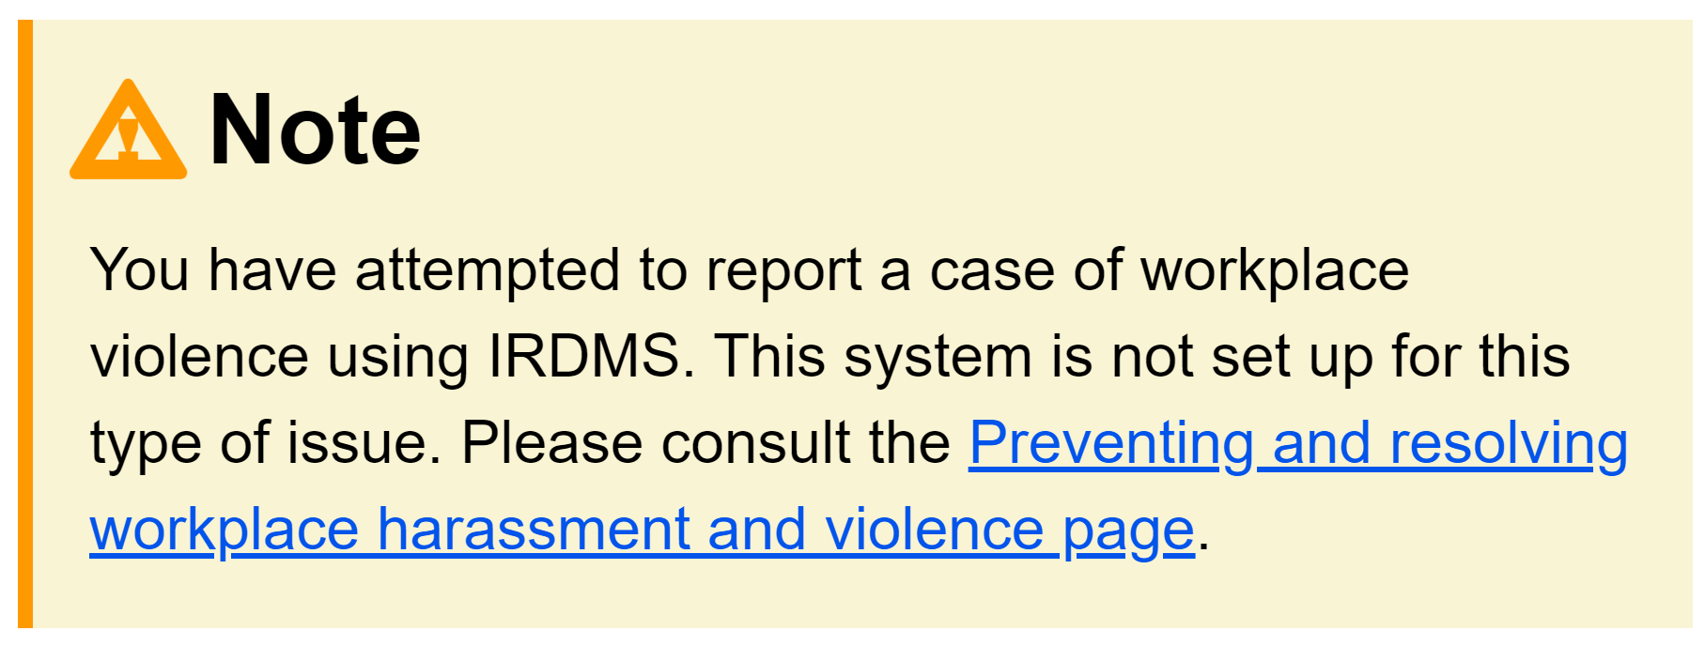

Reporting Workplace Harassment and Violence
Supervisors can report an injury related to “harassment and violence” to generate an Employer’s Record of Injury (Workers Compensation form) only.
Employees attempting to report a hazard relating to workplace harassment and violence will be guided to the appropriate reporting method.

Slide 28

Stream 1: Hazards/Complaints

Slide 29
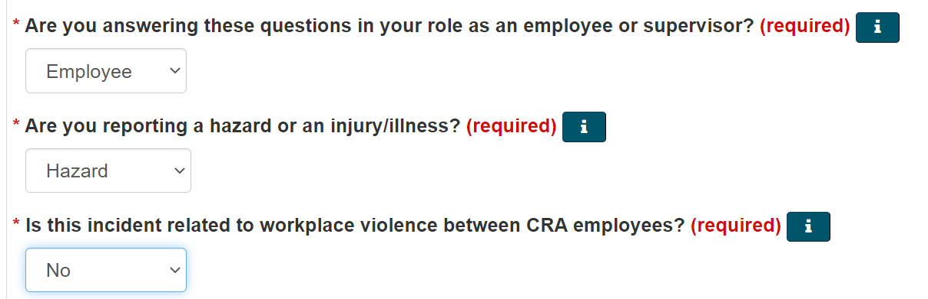
Stream 1 – Hazards/complaints
Both employee and supervisor will answer the same initial screening questions when attempting to submit a hazard report/complaint.

Slide 30
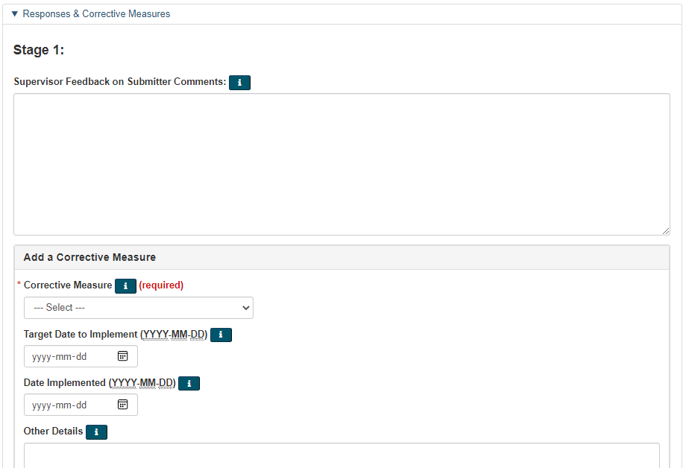
Hazard Case – Stage 1 – Supervisor Level
As per the Canada Labour Code 127.1, the employee must first raise the issue with their supervisor.
It is then the responsibility of the supervisor to review the alleged hazard/complaint and take appropriate action to reduce the risk before escalating the matter further.

Slide 31
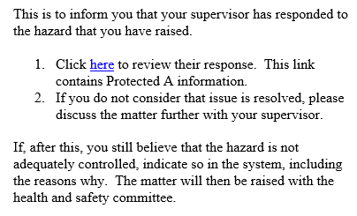
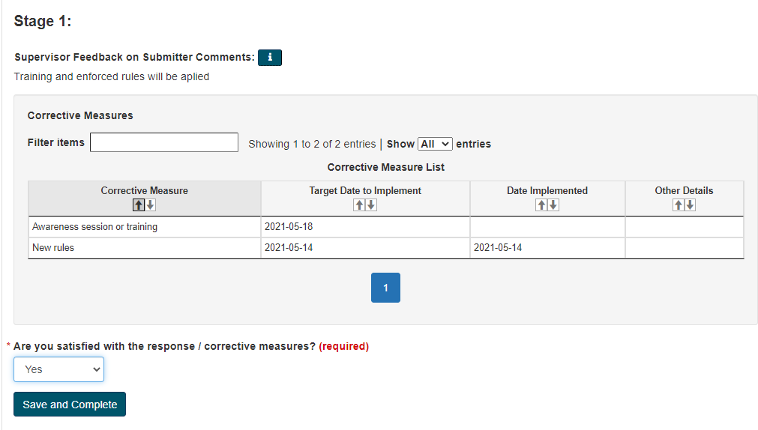

Hazard Case – Stage 1: Employee Notification

Slide 32

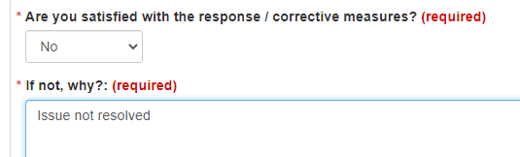
Hazard Case – Stage 2: HSC/HSR Level
If the employee does not agree with the proposed corrective measures, they should first discuss with their supervisor.
If the employee continues to disagree with the proposed corrective measure(s), the hazard case will go to the HSC/HSR level.

Slide 33
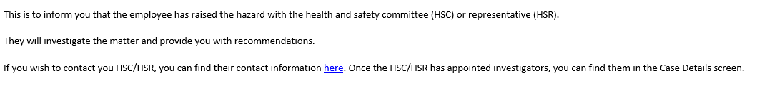
Hazard Case – Stage 2: Notification to the HSC/HSR
An automated email will be sent to the employee, the supervisor, and the local HSC/HSR.

Slide 34
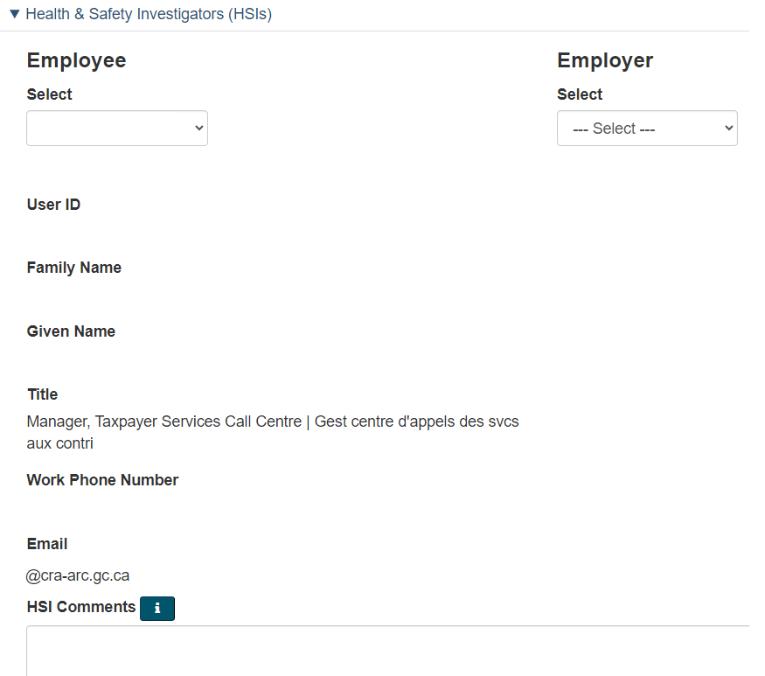
Hazard Case – Stage 2: Assigning Investigators

Slide 35
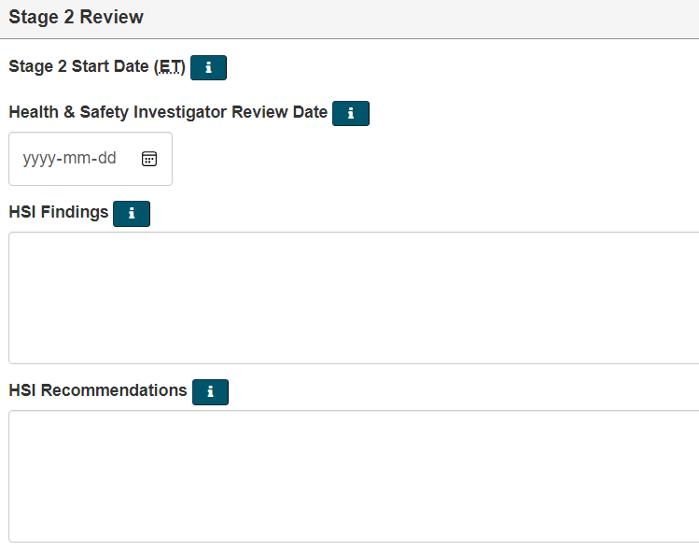
Hazard Case – Stage 2: HSI Response
The employee and the supervisor will be able to review the HSI’s recommendations.

Slide 36
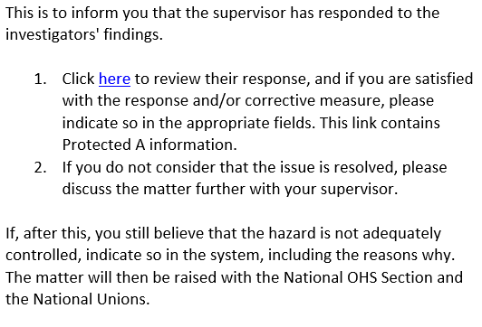
Hazard Case – Stage 2: Employee Review
The employee will receive a notification when the supervisor has added their input.
If the employee agrees with the response, the case will be closed.

Slide 37

Hazard Case – Stage 3: National level
If the employee does not agree with the corrective measures, the National OHS inbox will be sent a communication, and the National Union will be engaged.

Slide 38

Stream 2:
Injuries/Illnesses

Slide 39
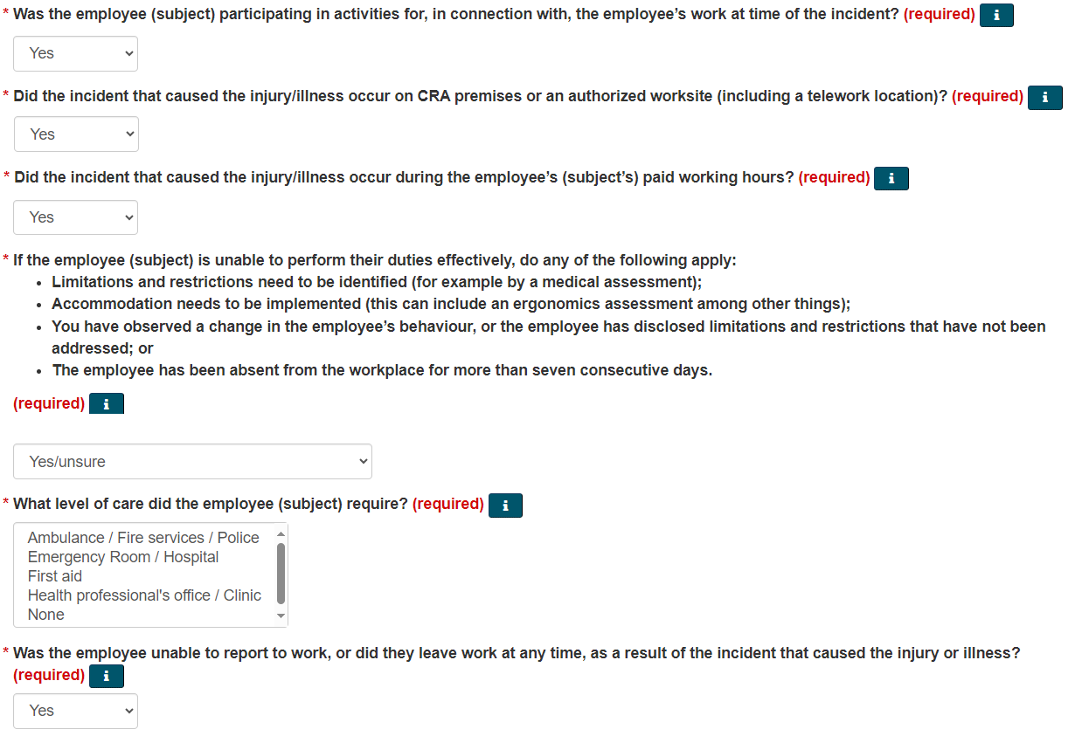
Stream 2 – Injury/Illness
Only supervisors are authorized to report occupational injuries and illnesses in IRDMS.
The supervisor must initiate the report in IRDMS and complete all the required components before it can be submitted.

Slide 40
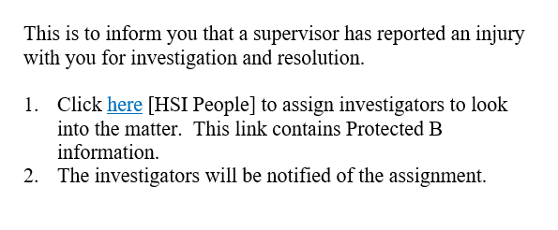
Injury/Illness Case – HSC/HSR Notification
The HSC/HSR will receive an automated email that an injury has been reported in the system.
Investigators must be manually assigned to the IRDMS case.

Slide 41
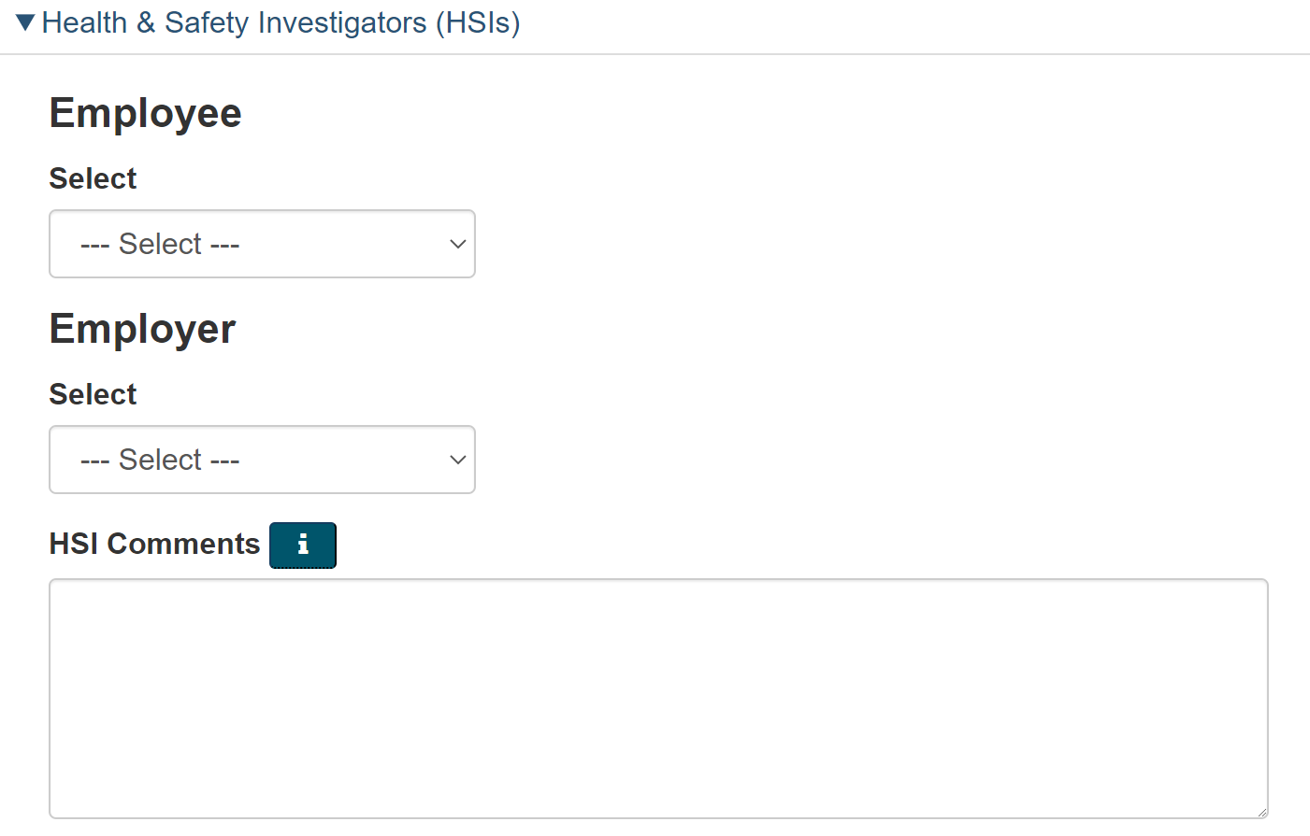
Injury/Illness Case – HSC/HSR Investigation
The HSC/HSR must conduct their investigation jointly with management.
All the details regarding the HSC/HSR involvement in the investigation can be detailed in the “HSI Comments” field.

Slide 42
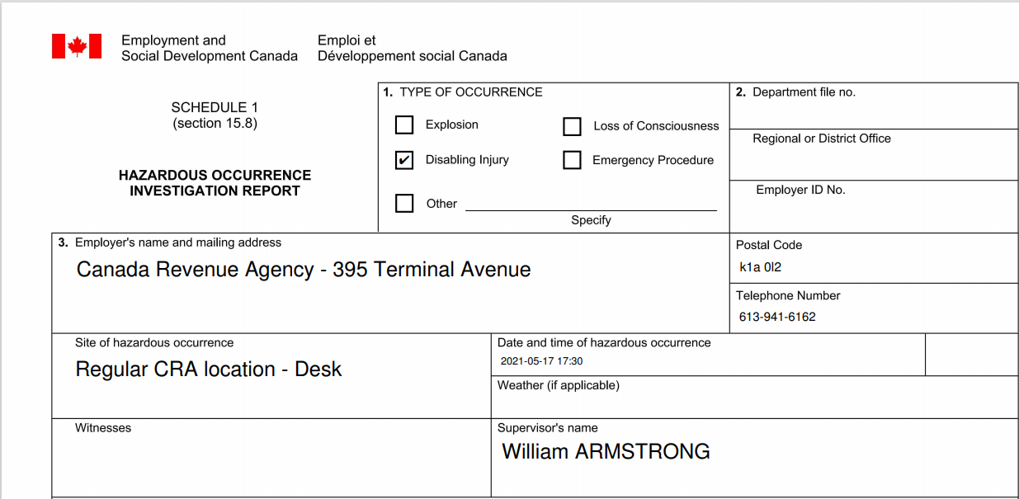
Generating LAB1070 Report
The LAB1070 will need to be signed by the supervisor and the HSI when applicable, and then sent to the OHS Officer, who will send it to the ESDC – Labour program.

Slide 43
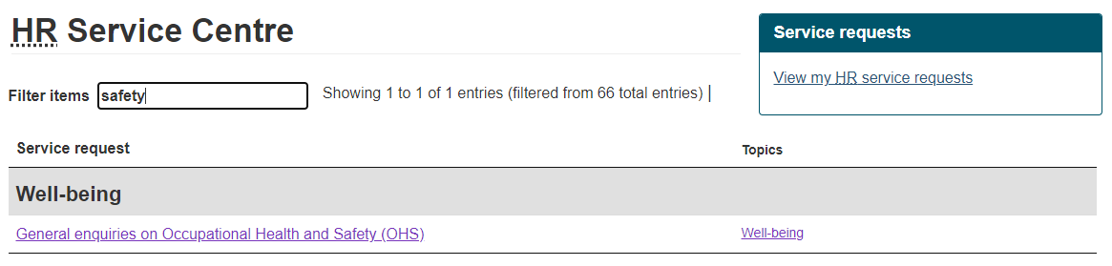
IRDMS - Support
For any questions or technical issues, health and safety committee members and representatives can reach out to their Regional OHS Officers for support.

Slide 44

OHS Report Application

Slide 45
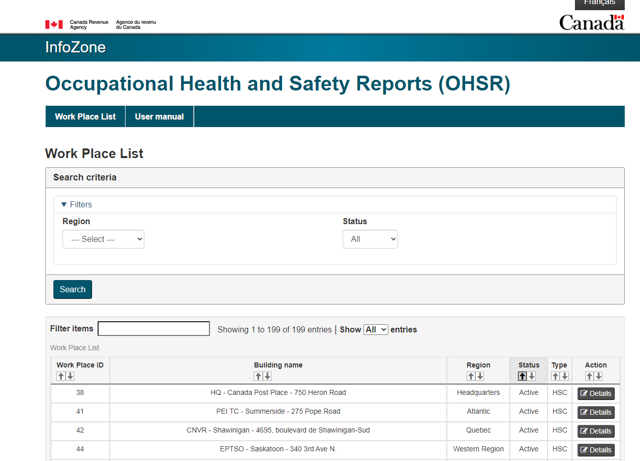
OHSR Portal

Slide 46
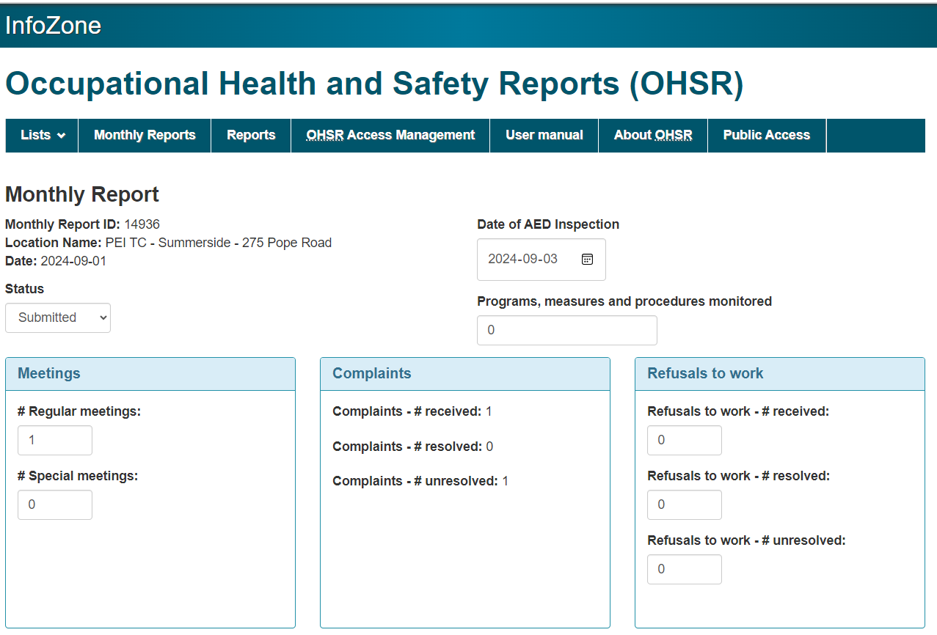
Monthly Reports

Slide 47
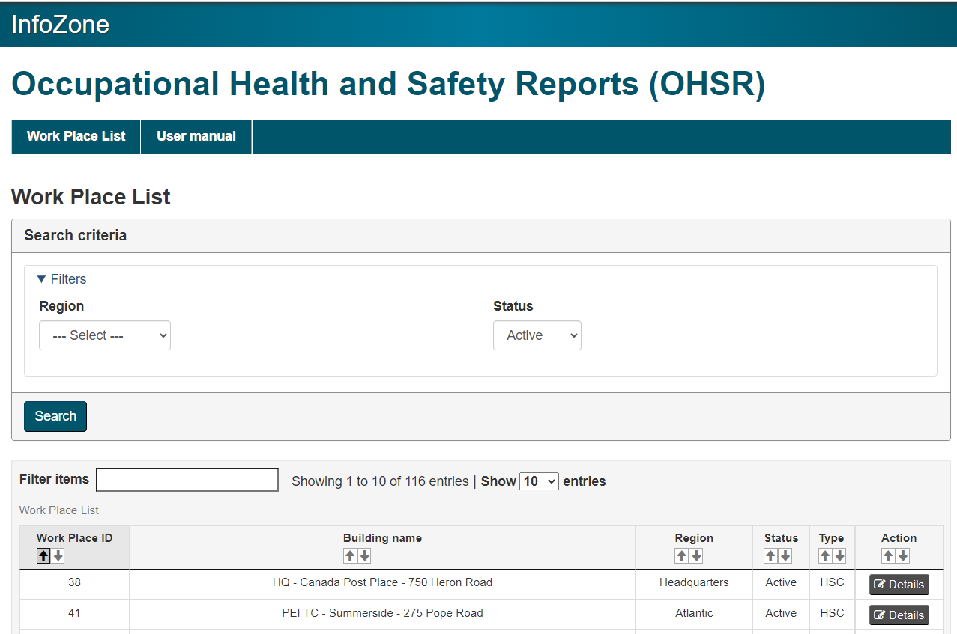
Meeting Minutes
Non-committee members may then easily view member details, meeting minutes and inspections by following the links provided on InfoZone.

Slide 48
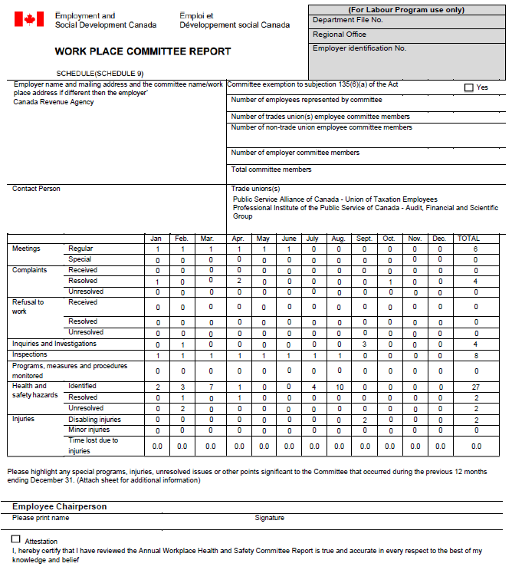
Annual Report

Slide 49
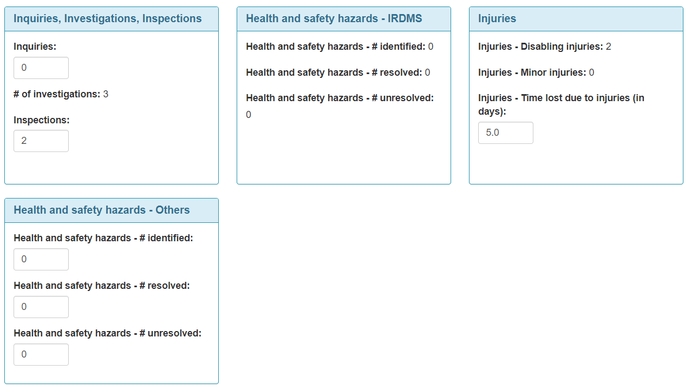
OHS Reports Application
IRDMS is directly connected to the OHS Reports application
HSC/HSR access to IRDMS is granted based on the user information in the OHS Reports application
Data from IRDMS will automatically populate certain fields within the OHS Reports Application.
There is an option to manually input hazards that the HSC/HSR encounter (ex: hazards found during monthly inspections).

Slide 50

HSC Mailbox
Be sure to check your HSC mailbox regularly

Slide 51
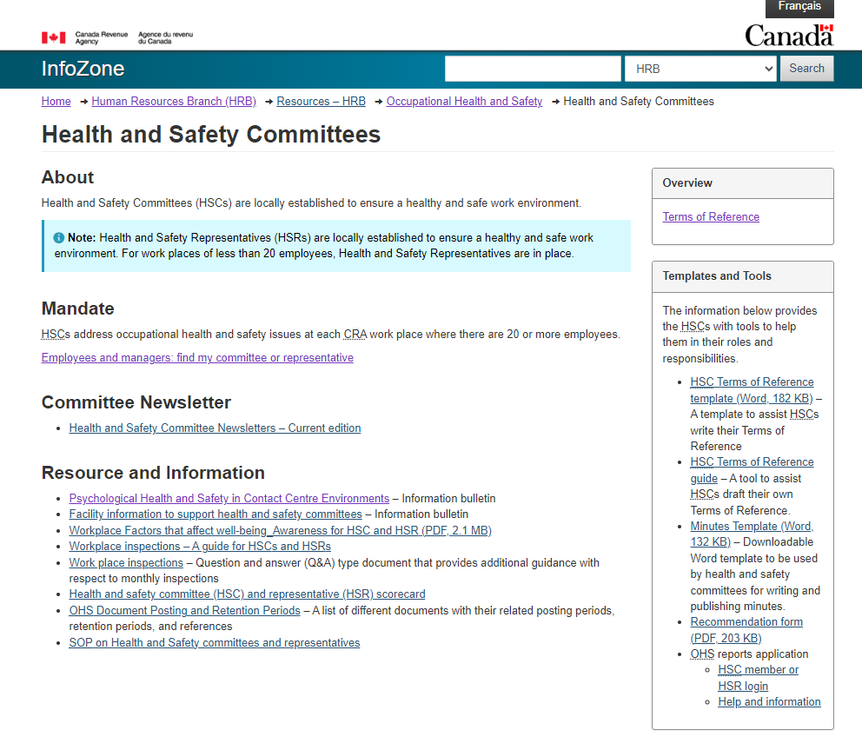
Resources and Tools

Slide 52

Ergonomics – Injury Prevention Program

Slide 53
When should I think about Ergonomics?
New employee
Mild discomfort
Changes in work
New workstation
Known limitations and restrictions

Slide 54
TIER 1 – Awareness / Self-adjustment
Consult the Ergonomics page
Complete the Office Ergonomics: Self-Adjustment Tool
Follow-up

Slide 55
TIER 2 – Ergonomics Coach
Request an Ergonomic Coach adjustment session
Review the adjustment report from the Ergonomic Coach
Discuss and implement the right ergonomic solutions

Slide 56
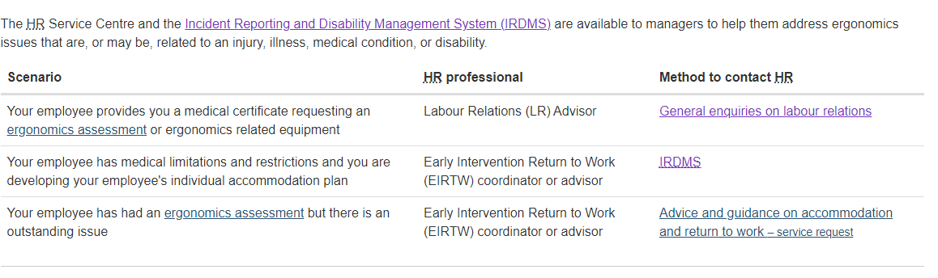
Ergonomic injury/illness
External ergonomic assessments are part of the medical process covered in the EIRTW approach and are not part of the prevention process.

Slide 57

Workplace harassment and violence

Slide 58
Legislation and regulations
The Canada Labour Code (CLC) is the federal legislation that governs workplace standards for federally regulated industries, including provisions related to occupational health and safety.
The Work Place Harassment and Violence Prevention Regulations were introduced under the CLC.
Key components of the Regulations:
Policy Development
Workplace Risk Assessment
Emergency Procedures
Training and Awareness
Support Measures for Affected Employees
Reporting and Resolution Procedures

Slide 59
Prescribed resolution process
Resolution process from the Work Place Harassment and Violence Prevention Regulations are different from the resolution process in Part XX of the Canada Occupational Health and Safety Regulations.
  Broadened definition of harassment and violence
  Terminology changes
  No Hazardous Occurrence Investigation Report (LAB1070) for harassment and violence
  Greater communication required
  Increased control for how occurrence is resolved
  Appointing of a "designated recipient"
  Specific roles for the health and safety committee or representative
  Timeframes

Slide 60
What is harassment and violence?
Harassment and violence as defined by the Canada Labour Code means “any action, conduct or comment, including of a sexual nature, that can reasonably be expected to cause offence, humiliation or other physical or psychological injury or illness to an employee, including any prescribed action, conduct or comment.”
What are some examples of harassment and violence?
  aggressive or threatening behaviour, including verbal threats or abuse
  physical assault
  spreading malicious rumours or gossip
  socially excluding or isolating someone
  damaging, hiding or stealing someone’s personal belongings or work equipment
  persistently criticizing, undermining, belittling, demeaning or ridiculing someone
  using the Internet to harass, threaten or maliciously embarrass someone

Slide 61
What is NOT harassment and violence?
What is NOT considered harassment and violence?
Differences of opinion between colleagues
Setting out performance expectations and providing constructive feedback about work performance
Taking measures to correct performance deficiencies, such as placing an employee on a performance improvement plan
Assigning work, and directing how and when it should be done

Slide 62
Resolution process overview
Notice of occurrence
Initial review
Responding party an employee?
No
Yes
Principal party decides to stop the process
Workplace Assessment
Avenues of resolution
Negotiated resolution
Conciliation
Investigation
Joint HSC/HSR and Management review
If resolves, no HSC/HSR involvement
Investigator’s report

Slide 63
Roles of the HSC or the HSR
Conducted jointly, with a management representative
Review – Workplace Assessment
Recommendations – Investigation
Identify risk factors that could have contributed to the occurrence
Determine if new preventive measures are needed
Jointly determine which recommendations in the investigation report to implement.
To learn more about the role of the HSC or HSR in this process, visit Workplace Harassment and Violence Prevention and Resolution Procedures.

Slide 64
Is there anything the HSC cannot participate in?
Changes were made to the Part II of the CLC that impact the role of the health and safety committee (HSC) or representative (HSR).
The employer may not provide the HSC/HSR or Policy Committee with any information that is likely to reveal the identity of a person who was involved in an occurrence of harassment and violence.
HSC/HSR cannot investigate complaints related to occurrences of harassment and violence.

Slide 65

Privacy
No information goes to the HSC/HSR (or NHSPC) that would directly or indirectly reveal the identity of any of the parties
  No Hazardous Occurrence Investigation Form (LAB1070)
The responding party may not be notified, depending on avenue of resolution
  However, if contacted, they can receive the details of the occurrence
Witnesses will not receive the details of the occurrence

Slide 66
Roles of the support person and the HSC member
Support person
HSC member

Slide 67

What if a member or colleague approaches you, and they want to report an occurrence of harassment and violence?

Slide 68

Questions

Slide 69

Additional Information

Slide 70

For more information
Explore these internal and external resources:
  CRA Well-being Approach for 2023 and Beyond
  An overview of the well-being approach for all employees.
Canada School of Public Service: Mental Health Learning Series
  This resource contains a series of job aids and videos on each of the 13 factors, including an introductory video.
Guarding Minds at Work: Understand Factors and Hazards (www.guardingmindsatwork.ca)
Information on psychosocial factors, hazards, and indicators.
Canadian Centre for Occupational Health and Safety: Psychological Health and Safety (www.ccohs.ca)
This resource provides fact sheets on assessing and controlling psychosocial hazards.

Slide 71
13 Workplace Factors- Information Cards
The following information cards are intended to give you insight on the 13 workplace factors that can affect well-being and psychological health and safety in the workplace.
Each card contains:
the Government of Canada definition of the workplace factor ^{[5]}
an explanation of what that factor looks like in the work environment when it is well managed (adapted from the CSA Standard) ^{[3]}

Slide 72
Psychological and social support
Definition
What it looks like in practice
A work environment where co-workers and supervisors are supportive of psychological and mental health concerns, and respond appropriately as needed.
The employer offers services or benefits that address employee psychological and mental health.
Employees feel that they are part of a community and that the people they are working with are helpful in fulfilling the job requirements.
The employer has a process in place to intervene if an employee looks distressed while at work.
Employees feel supported when they are dealing with personal or family issues.
The employer supports employees who are returning to work after time off due to a mental health condition.
Employees and supervisors have a good understanding of the importance of mental health.

Slide 73
Organizational culture
Definition
What it looks like in practice
A work environment characterized by trust, honesty, and fairness.
All people in the workplace are held accountable for their actions.
People at work show sincere respect for others’ ideas, values, and beliefs.
Difficult situations at work are addressed effectively and as early as possible.
Employees feel that they are part of a community at work.
Employees and management trust one another.
Employees feel comfortable expressing themselves in the official language of their choice.

Slide 74
Clear leadership and expectations
Definition
What it looks like in practice
A work environment where there is effective leadership and support that helps employees know what they need to do, how their work contributes to the organization, and whether there are changes coming.
In their jobs, employees know what they are expected to do.
Leadership in the workplace is effective.
Employees are informed about important changes at work in a timely manner.
Supervisors provide helpful feedback to employees on their performance.
The employer provides clear and effective communication.

Slide 75
Civility and respect
Definition
What it looks like in practice
A work environment where employees are respectful and considerate in how they interact with one another, as well as with customers, clients, and the public
People treat each other with respect and consideration in the workplace.
The employer effectively handles conflicts between stakeholders (employees, customers, clients, public, suppliers, etc.).
Employees from all backgrounds are treated fairly.
The employer has effective ways of addressing inappropriate behaviour by employees, customers, the public or clients.

Slide 76
Psychological demands
Definition
What it looks like in practice
A work environment where employees’ interpersonal and emotional competencies fit with the requirements of their position.
The employer considers existing work systems and allows for work redesign.
The employer assesses employee demand and job control issues such as physical and psychological job demands.
The employer assesses the level of job control and autonomy afforded to its employees.
The employer values employee input particularly during periods of change and the execution of work.
The employer emphasizes recruitment, training, and promotion practices that aim for the highest level of interpersonal competencies at work.

Slide 77
Growth and development
Definition
What it looks like in practice
A work environment where employees receive encouragement and support in developing their interpersonal, emotional, and job skills.
Employees receive feedback at work that helps them grow and develop.
Supervisors are open to employee ideas for taking on new opportunities and challenges.
Employees have opportunities to advance within their organization.
The employer values employees’ ongoing growth and development.
Employees have the opportunity to develop their “people skills” at work.

Slide 78
Recognition and reward
Definition
What it looks like in practice
A work environment where there is appropriate acknowledgment and appreciation of employees’ efforts in a fair and timely manner.
Immediate supervisors demonstrate appreciation of employees’ contributions.
Employees are paid fairly for the work they do.
The employer appreciates efforts made by employees.
The employer celebrates shared accomplishments.
The employer values employees’ commitment and passion for their work.

Slide 79
Involvement and influence
Definition
What it looks like in practice
A work environment where employees are included in discussions about how their work is done and how important decisions are made.
Employees are able to talk to their immediate supervisors about how their work is done.
Employees have some control over how they organize their work.
Employees’ opinions and suggestions are considered.
Employees are informed of important changes that can impact how their work is done.
The employer encourages input from all employees on important decisions related to their work.

Slide 80
Workload management
Definition
What it looks like in practice
A work environment where tasks and responsibilities can be accomplished successfully in the time available.
The amount of work employees are expected to do is reasonable for their positions.
Employees have the equipment and resources needed to do their jobs well.
Employees can talk to their supervisors about the amount of work they have to do.
Employees’ work is free from unnecessary interruptions and disruptions.
Employees have an appropriate level of control over prioritizing tasks and responsibilities when facing multiple demands.

Slide 81
Engagement
Definition
What it looks like in practice
A work environment where employees feel connected to their work and are motivated to do their job well.
Employees enjoy their work.
Employees are willing to give extra effort at work if needed.
Employees describe their work as important.
Employees are committed to the success of the organization.
Employees are proud of the work they do.

Slide 82
Balance
Definition
What it looks like in practice
A work environment where there is recognition of the need for balance between the demands of work, family, and personal life.
The employer encourages employees to take their entitled breaks (e.g., lunchtime, sick time, vacation time, earned days off, parental leave).
Employees are able to reasonably meet the demands of personal life and work.
The employer promotes life-work harmony.
Employees can talk to their supervisors when they are having trouble maintaining harmony between their life and work.
Employees have energy left at the end of most workdays for their personal life.

Slide 83
Psychological protection
Definition
What it looks like in practice
A work environment where employees’ psychological safety is ensured.
The employer is committed to minimizing unnecessary stress at work.
Immediate supervisors care about employees’ emotional well-being.
The employer makes efforts to prevent harm to employees from harassment, bullying, discrimination, violence, or stigma.
Employees would describe the workplace as being psychologically healthy.
The organization deals effectively with situations that can threaten or harm employees (e.g. harassment, bullying, discrimination, violence, stigma, etc.).
Employees are encouraged to use the official language of their choice.

Slide 84
Protection of physical safety
Definition
What it looks like in practice
A work environment where employees’ physical safety is ensured.
The employer cares about how the physical work environment impacts mental health.
Employees feel safe in their physical work environment.
The way work is scheduled allows for reasonable rest periods.
All health and safety concerns are taken seriously.
Employees asked to do work that they believe is unsafe, have no hesitation in refusing to do it.
Employees get sufficient training to perform their work safely.
The employer assesses the psychological demands of the jobs and the job environment to determine if it presents a hazard to employees’ health and safety.

Slide 85
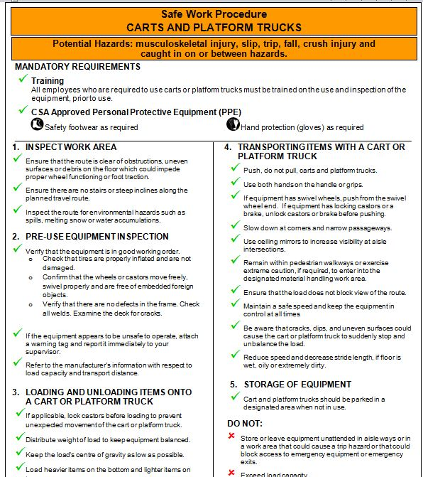
Corporate policy instruments (CPI)
Standard operating procedure (SOP)
  clearly outlines the roles and responsibilities of the stakeholders
  sets out general instructions
Safe work procedure (SWP)
  flows from a SOP
  offers concise and detailed step-by-step instructions on how to complete a given task safely including what not to do
  outlines the training and the personal protective equipment (PPE) requirement
  follows a standardized format

Slide 86
What does this mean for your HSC?
These documents must be easily accessible to every employee that does the related task, such as visibly posted on a wall near where the task is completed.
Your HSC should make sure that employees and managers are aware of SOPs and SWPs.
When conducting inspections, your HSC can monitor activities against the SWP to make sure tasks are being conducted safely.

